Slide 1
Báo cáo 1
Nhóm 6

Slide 2
IDEA
AFBA
A Fashion Brand App

Slide 3
WHEN
Nextweek for first rerease
AFBA

Slide 4
Why we want to do it
AFBA

Slide 5
Why we want to do it
Strength
Weakness
Opportunity
Threat
AFBA

Slide 6
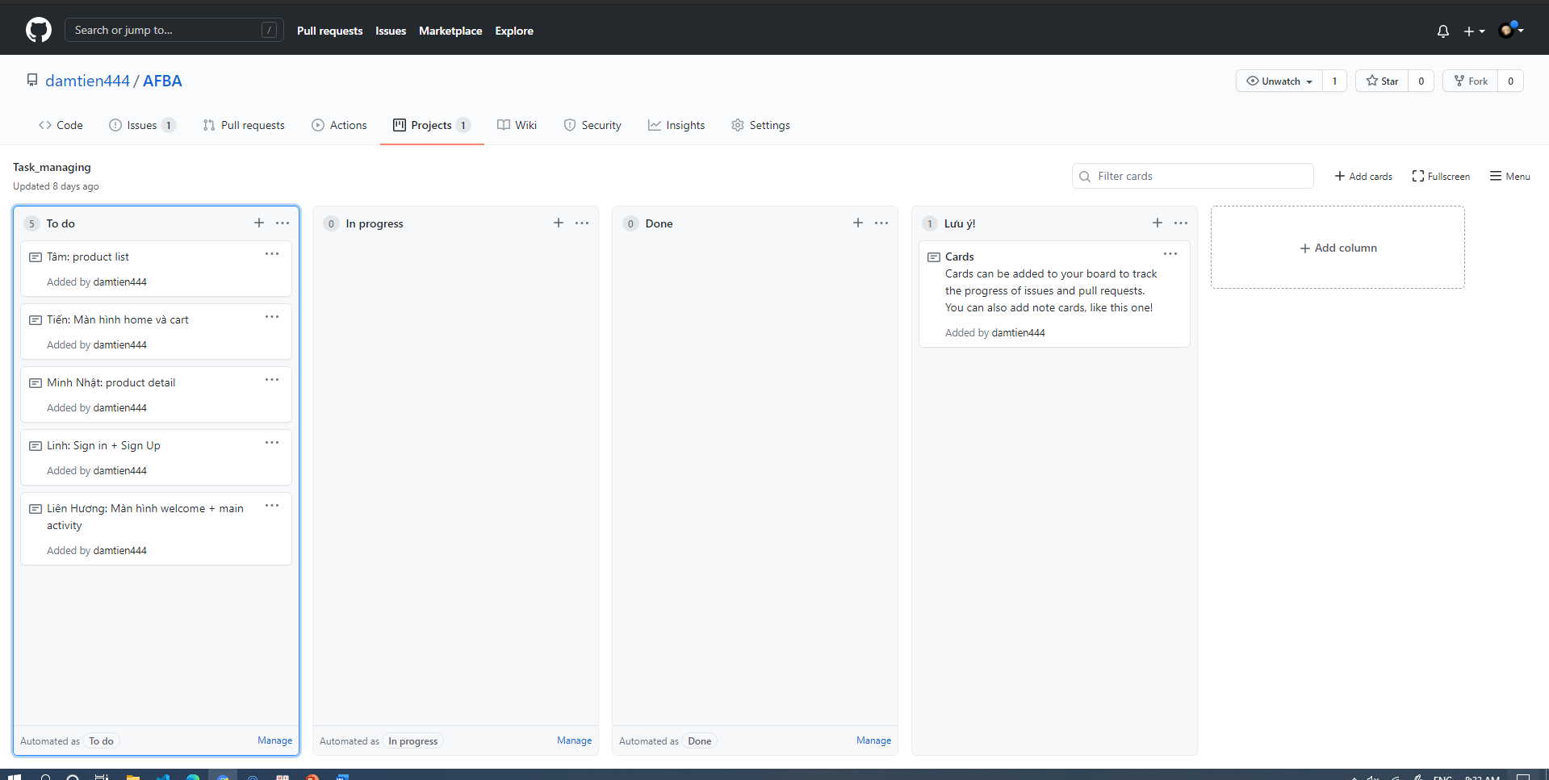
Task management
AFBA

Slide 7
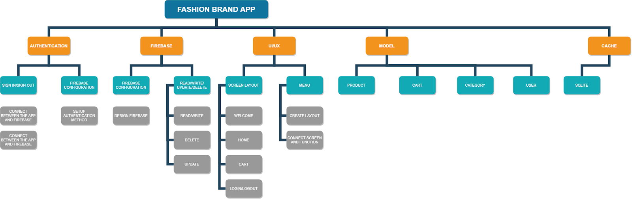
AFBA
Work breakdown structure

